Slide 1
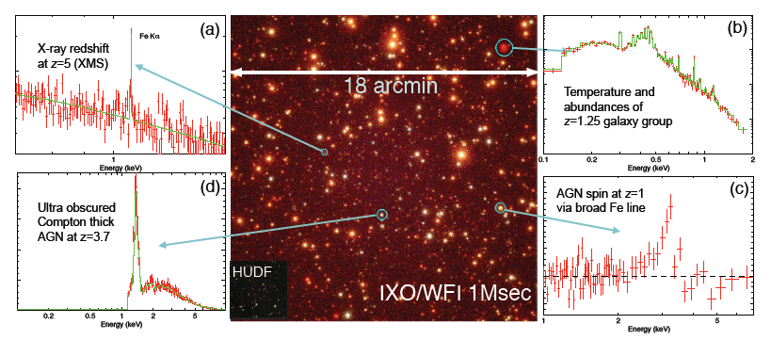
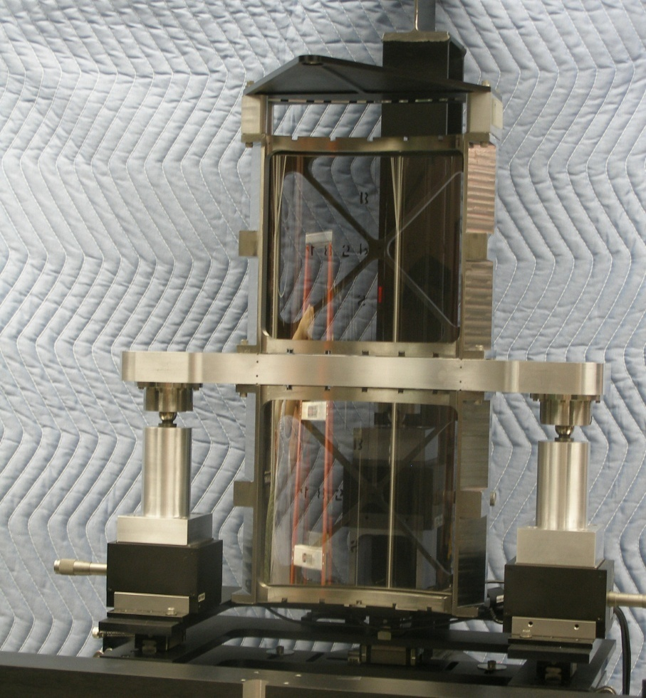
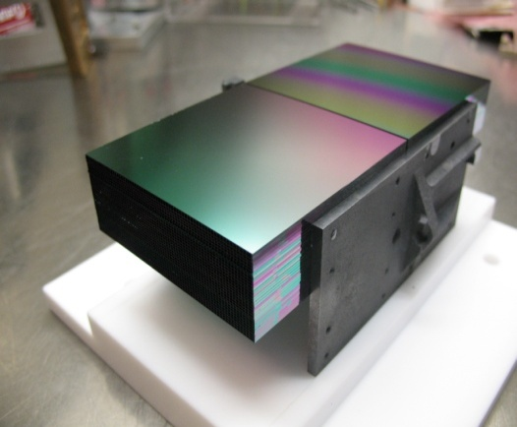
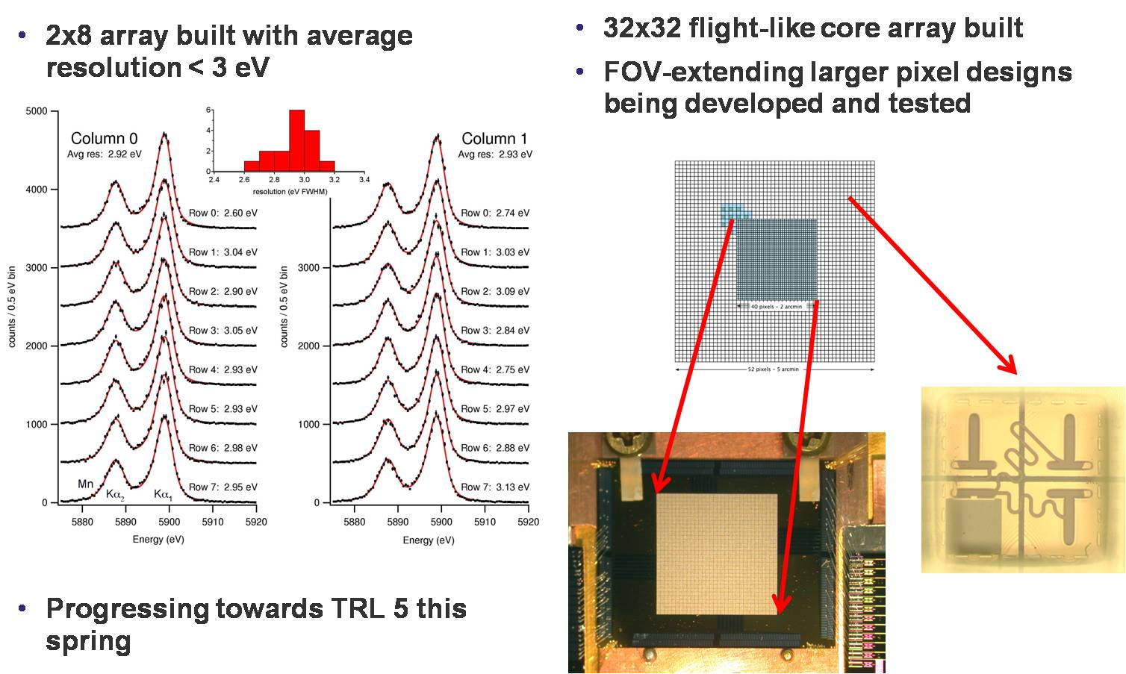
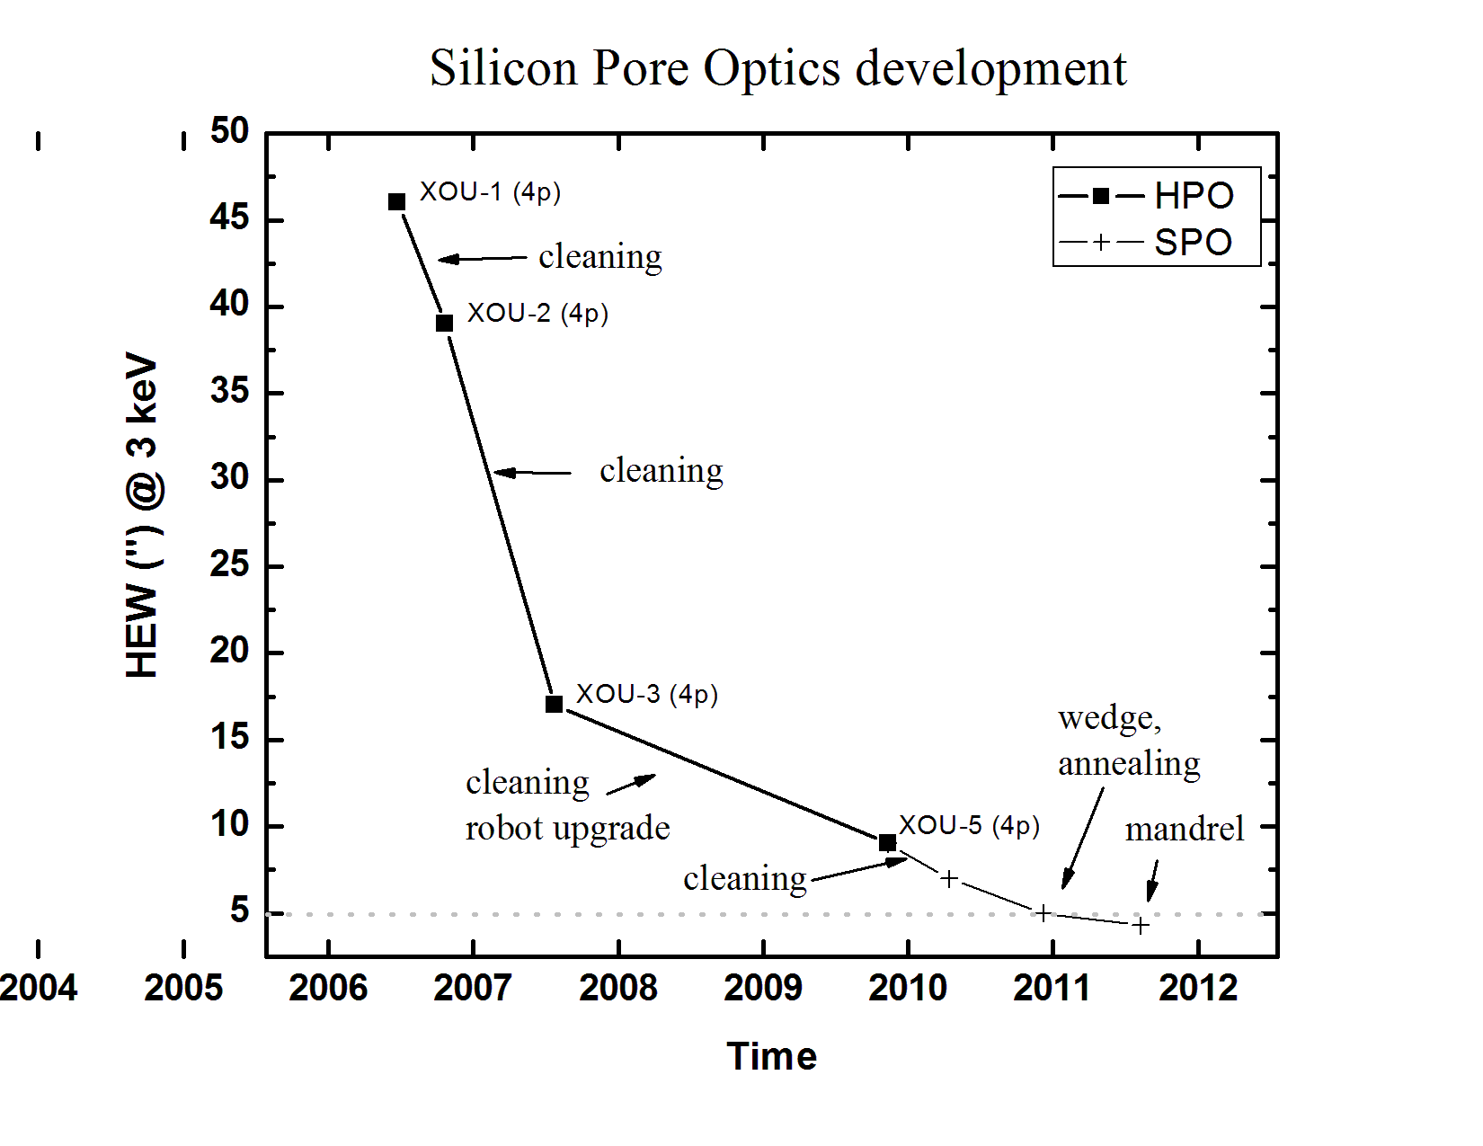
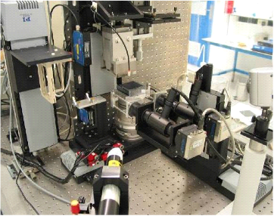
The International X-ray Observatory: Science and Technology Update
Michael Garcia and the IXO Team
Exploring The Hot Universe with IXO
    The International X-Ray Observatory, a joint NASA-ESA-JAXA effort, is a next generation X‑ray telescope that will answer many fundamental questions in contemporary astrophysics under three main science themes:
    1) Black Holes and Matter Under Extreme Conditions
    2) Formation and Evolution of Galaxies, Clusters, and Large Scale Structure
    3) Life Cycles of Matter and Energy
    IXO is a general user observatory that builds on the 3000 strong Chandra and XMM-Newton user community. The scientific problems that IXO will ultimately address will be driven by community proposals.
    To address these questions, IXO will employ optics with 20 times more collecting area at 1 keV than any previous X-ray telescope. The focal plane instruments will deliver up to 100-fold increase in effective area for high resolution spectroscopy from 0.3-10 keV, deep spectral imaging from 0.1-40 keV over a wide field of view, unprecedented polarimetric sensitivity, and microsecond spectroscopic timing with high count rate capability.
    The Hot Universe
    The X-ray sky is dominated by two kinds of sources: accreting supermassive black holes (SMBH) in galactic nuclei, comparable in size to the Solar System, and clusters of galaxies, more than a million lightyears across. What is perhaps most remarkable is the discovery that these two are inextricably linked. The energy liberated by growing black holes influences the infall of gas in galaxies and clusters, while some analogous process, still poorly understood, ties the growth of black hole mass to a fixed fraction of its host galaxy’s bulge – a two-way connection called “feedback.” On the smallest scales, X-rays provide unique electromagnetic spectral signatures from the regions of strong gravity near black holes and neutron stars.
    The principal aims of IXO are to study the extreme environment and evolution of black holes, the energetics and dynamics of the hot gas in large cosmic structures and the connection between the two phenomena. IXO will also enable revolutionary studies of virtually every class of astronomical object and is sure to make serendipitous discoveries, characteristic of all major advances in astronomical capabilities.
Large Scale Structure
How did large scale structure evolve? X-ray observations reveal the largest bound structures in the Universe and their evolution on cosmological time-scales. The dominant form of baryons in these clusters of galaxies is hot (T > 10⁷ K) gas, which can be probed only in X-rays. The mystery of dark energy can be studied by observing either the expansion history of the universe or the growth of matter density perturbations. X-ray observations of galaxy clusters with IXO will provide both tests Cosmological Studies with a Large-Area X-ray Telescope, Vikhlinin et al. 2009).
Black Holes and Feedback
Extreme Conditions: Black Holes
There are two primary feedback mechanisms: 1) The radiative output of the black hole can heat the surrounding gas and dust, and drive it via radiation pressure; and 2) If significant AGN power emerges in winds or jets, mechanical heating and pressure can provide the link between the SMBH and the surrounding material (Fundamental Accretion and Ejection Astrophysics, Miller et al. 2009). The high spectral resolution and imaging capability of IXO will provide the necessary spectral diagnostics for studying and distinguishing between both forms of feedback (Cosmic Feedback from Massive Black Holes, Fabian et al. 2009).
• What is the structure of space-time near the event horizon? The strongest gravitational fields in the Universe occur around black holes, where the extreme effects of General Relativity (GR) are evident in the form of gravitational redshift, light bending, and frame dragging. The spectral signatures needed to determine the physics of the accretion flow into the black hole themselves are only found in X-rays.
The growth of structure as a function of z for simulated observations with IXO of 2000 clusters at z=0-2. The dashed line shows the growth expected in one of the non-GR models of cosmic acceleration. The inset illustrates improvements in the dark energy equation of state constraints from a combination of distance-redshift and structure growth methods.
Galaxy and Black Hole Evolution
Extragalactic astronomy explores the dawn of the modern Universe when the first galaxies formed. Future observatories, including JWST, ALMA and 30m-class ground-based telescopes will intensively observe the starlight from the first galaxies. IXO will play a crucial role in this broad investigation by studying the accretion light from the first SMBHs (10⁷-10⁹ M). SMBHs are now known to be an integral part of typical massive galaxies.
A key design goal of IXO is to chart “The Growth of Supermassive Black Holes Over Cosmic Time” (Nandra et al. 2009). In order to do so, IXO is designed to reach Chandra’s limiting sensitivity 20× faster.
IXO will study this feedback, such as the strong jets found in cluster AGN shown in this Chandra/VLA image of Hydra A. AGN have a profound effect on the growth of structure in the Universe and IXO’s non-dispersive spectral/spatial measurements with 2.5 eV spectral resolution (inset spectrum) will determine the temperature, ionization state, and velocities in the intra-cluster medium, catching “feedback” processes in action. The overlaid circles show show 100-150 kpc extraction regions. (Image adapted from Wise et al. 2007).
The image at top shows the disk around a black hole as seen in the Fe-Kα line. Hot spots in the disk trace nearly ‘test particle’ orbits. The two panels at the bottom show the arcs traced by these hot spots in the time/energy plane, the left panel showing the model of emission from a single hot spot, and the right panel showing simulated IXO data of the ensemble. GR makes specific predictions for the form of these arcs, and the ensemble of arcs determines the mass and spin of the black hole and the inclination of the accretion disk. IXO will be the first observatory with sufficient area at FeKα to allow these time-resolved measurements.
Life Cycles of Matter and Energy
Are black holes in the centers of galaxies spinning? General relativistic effects created by rotating black holes broaden and redshift Fe-Ka lines, allowing measurements of the intrinsic spin of the black hole. At low spin (a=0, top) the inner edge of the disk is truncated at larger radius and the profile is less broadened than with high spin (a=0.998, bottom)
The leap in effective area and high-resolution spectroscopic capabilities of IXO will enable major advances in every field of astrophysics. The dispersal of metals from galaxies can occur as starbursts drive out hot gas that is both heated and enriched by supernovae. This hot gas has been detected with current X-ray missions, but IXO is needed to measure the actual hot gas flow velocity using high-throughput spectroscopic imaging to determine the galactic wind properties and their effects (Starburst Galaxies: Outflows of Metals and Energy into the IGM, Strickland et al. 2009). The figure to the right shows an IXO high resolution spectrum(blue) of this metal-enriched hot gas out-flowing from a starburst galaxy, a part of the feedback process unresolvalbe with current X-ray CCD data (magenta).
The above WFI simulation of the Chandra Deep Field South with Hubble Ultra Deep Field (HUDF) in inset. Simulated spectra of various sources are shown, illustrating IXO’s ability (clockwise from top left) to: a) determine redshift autonomously in the X-ray band, b) determine temperatures and abundances even for low luminosity groups to z>1, c) make spin measurements of AGN to a similar redshift, and d) uncover the most heavily obscured, Compton-thick AGN.
Top Level Requirements: The IXO technologies will provide an observatory which will meet or exceed the top level requirements shown below. The large effective area will be provided with either segmented, thermally formed mirrors or with silicon pore optics. A down-select based on performance and cost will be made in 2012.
Technology Update
X-ray Microcalorimeter Spectrometer: We are quickly closing in on the required performance for this breakthrough imaging spectrometer. Left figure shows good energy resolution of several rows after the multiplexing readout, right shows configuration of inner and outer arrays.
Decadal Survey Astro2010 and Cosmic Visions 2015-2025:
We have responded to two Requests for Information (RFIs) from the Decadal Survey panels and are expecting to hear the survey results in ~Sept 2010. The RFIs can been seen on the IXO website at ixo.gsfc.nasa.gov. The equivalent process in Europe has started, and we anticipate our inputs being complete in Sept 2010, with results announced in March 2011. Launch could be as early as 2021.
Thermally Formed Mirror Segments: We have been making good progress toward achieving the 3.3’’ HPD requirement for the mirror segments. We are transitioning to new mandrels as the existing ones limit further progress. A pair of segments mounted in a vertical alignment test rig is shown on the right.
Silicon Pore Optics: Good progress is also being made on this European led technology (figure below/left). Individual plates have been stacked into segments, and the assembly robot (bottom) has been upgraded.
Date | HPD (two reflections) | Comment
Pre 2007 | ~16” | Progress in reducing mid-frequency errors - using normal incidence metrology Metrology validated by X-ray testing
August 2009 | ~12”
October 2009 | ~10”
December 2009 | ~8.5”
January 2010 | ~7.5”
2010, 2011: Transitioning from existing mandrels (~6.5”) to new mandrels (~2.4”) will approach the 3.3’’ required for IXO

