Slide 1
Modeling Diffuse X-ray Emission around the Galactic Center from Colliding Stellar Winds
arXiv:1607.01562
Christopher M. P. Russell
NASA
Goddard Space Flight Center
Q. Daniel Wang University of Massachusetts Amherst
Jorge Cuadra Pontificia Universidad Católica de Chile
IAU 322: The Multi-Messenger Astrophysics of the Galactic Centre July 18, 2016

Slide 2
Observations – Chandra XVP
(Wang+13)
X-ray Visionary Program
25”
3Ms
Diffuse emission
Emission from SMBH PWN G359
20”
Chandra 0th Order ACIS-S/HETG
1-9 keV

Slide 3
Observations – Chandra XVP
(Wang+13)
X-ray Visionary Program
25”
3Ms
Diffuse emission
Emission from SMBH PWN G359
20”
Chandra 0th Order ACIS-S/HETG
1-9 keV

Slide 4
Hydrodynamics - SPH (Cuadra+08)
smoothed particle hydrodynamics
30 Wolf-Rayet stars within 12” (~1 pc)
Orbits (except z) from IR monitoring (Paumard+06)
Wind properties from IR spectral fitting (Martins+07)
dM/dt ~ 0.5-10 x 10⁻⁵ M_{sun}/yr
Largest mass-loss-rate objects in vicinity
v∞ ~ 600-2500 km/s
Shocks -> thermal X-rays

Slide 5
Hydrodynamics - SPH (Cuadra+08)
smoothed particle hydrodynamics
30 Wolf-Rayet stars within 12” (~1 pc)
Orbits (except z) from IR monitoring (Paumard+06)
Wind properties from IR spectral fitting (Martins+07)
dM/dt ~ 0.5-10 x 10⁻⁵ M_{sun}/yr
Largest mass-loss-rate objects in vicinity
v∞ ~ 600-2500 km/s
Shocks -> thermal X-rays
Initial condition: run N-Body backwards 1100 yr
Simulation: point masses (stars) eject SPH particles (stellar winds) over 1100 yr to present day
Result: ρ & T structure in r<12” centered on SMBH

Slide 6
Column Density
(Cuadra+08)
12x12”
~1x1 pc

Slide 7
Column Density
(Cuadra+08)
12x12”
~1x1 pc

Slide 8
ρ
T
12” x 12”
2 keV X-rays
7 keV X-rays

Slide 9
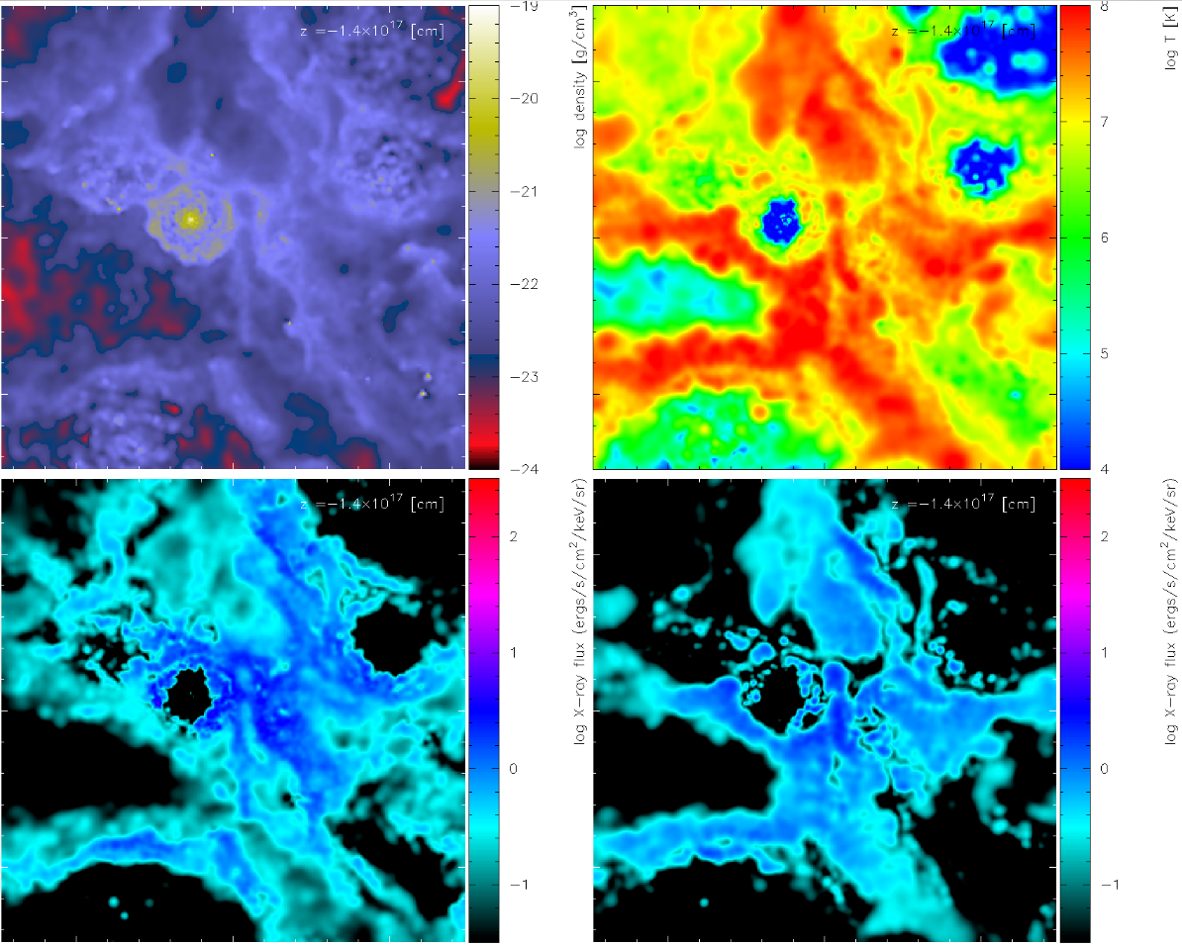
ρ
T
12” x 12”
2 keV X-rays
7 keV X-rays

Slide 10
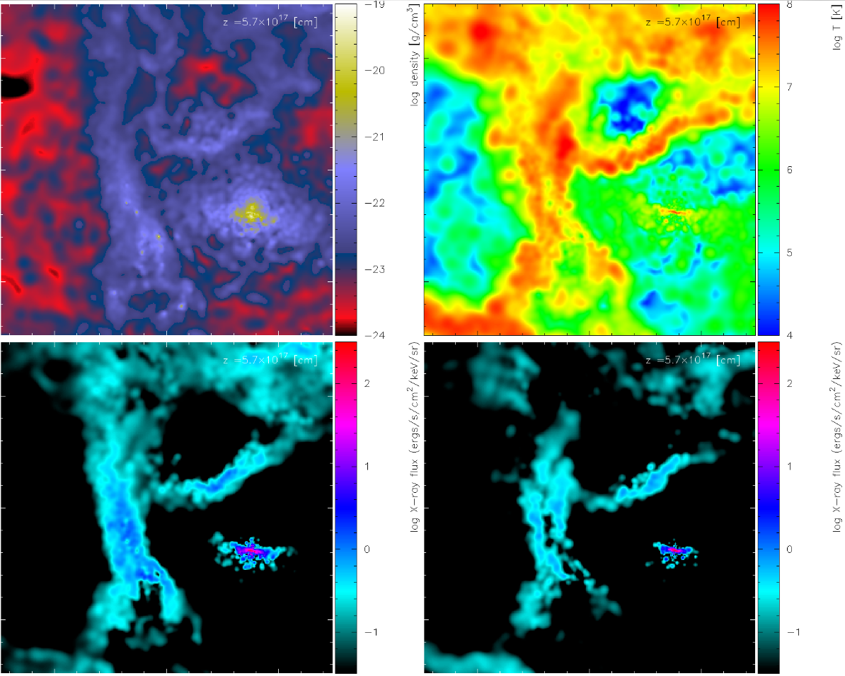
ρ
T
12” x 12”
2 keV X-rays
7 keV X-rays

Slide 11
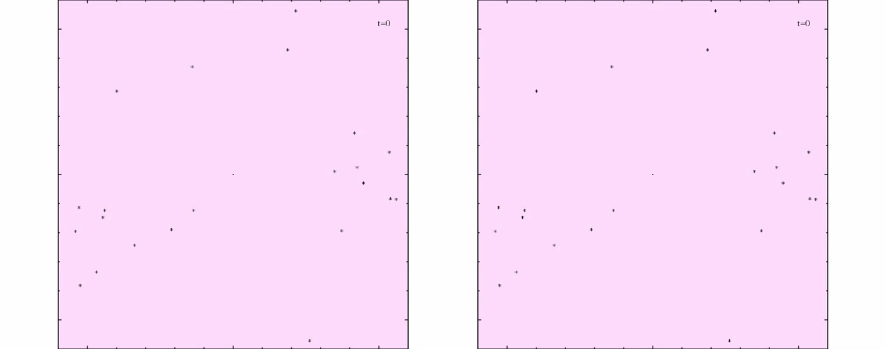
Sgr A* Outflow
radiatively inefficient accretion flow (RIAF) (Wang+13)
increased X-ray activity in past
(Ponti+10)
(Cuadra+15)
v_out = 5,000 km/s v_out = 10,000 km/s
Mdot_out = 1e-4 M_{sun}/yr
t_out = 400 to 100 yr ago
medium
strong

Slide 12
Sgr A* Outflow
radiatively inefficient accretion flow (RIAF) (Wang+13)
increased X-ray activity in past
(Ponti+10)
(Cuadra+15)
v_out = 5,000 km/s v_out = 10,000 km/s
Mdot_out = 1e-4 M_{sun}/yr
t_out = 400 to 100 yr ago
medium
strong

Slide 13
Column density
1pc, 12”
increasing
outflow
strength
no outflow
max outflow

Slide 14
Column density
1pc, 12”
weak
medium
none
strong
increasing
outflow
strength
no outflow
max outflow

Slide 15
X-ray Calculation (Russell13)
Sum emissivities along 1D rays through simulation
Well into optically thin limit, so don’t need to solve formal solution to radiative transfer
Radiative transfer program basis: SPLASH (Price07), SPH visualization code
Emissivity: APEC (Smith+01) from XSpec (Arnaud+97)
Opacity: windtabs (Leutenegger+10)
ISM Opacity: TBabs (Wilms+00) from XSpec

Slide 16
X-ray Calculation (cont.)
Abundances:
WN8-9 & Ofpe/WN9: CMFGEN models http://kookaburra.phyast.pitt.edu/hillier/web/CMFGEN.htm
WN5-7: Onifer+08
WC8-9: Crowther+07
Response Function Folding: ACIS-S/HETG 0th order
PSF Folding: 0.5” FWHM Gaussian
-> Direct comparison with observations
one free parameter: n_{H} (ISM absorbing column)

Slide 17
X-ray Image: Models vs. Data
(Russell, Wang & Cuadra 16, arXiv:1607.01562)
1pc, 12”
pre-PSF folding with PSF folding data
4-9 keV ACIS-S/HETG 0th order, no-outflow model

Slide 18
X-ray Image: Models vs. Data
(Russell+16)
pre-PSF with PSF data with PSF pre-PSF
increasing
outflow
strength
4-9 keV ACIS-S/HETG
0th order

Slide 19
X-ray Image: Models vs. Data
(Russell+16)
Intensity vs radius
Excludes IRS 13E & PWN

Slide 20
X-ray Image: Models vs. Data
(Russell+16)
Intensity vs radius
Excludes IRS 13E & PWN
medium
feedback

Slide 21
X-ray Image: Models vs. Data
(Russell+16)
Intensity vs radius
Excludes IRS 13E & PWN
--> no/weak fb

Slide 22
X-ray Image: Models vs. Data
(Russell+16)
Intensity vs radius
Excludes IRS 13E & PWN
medium feedback: <10% below data

Slide 23
X-ray Spectra: Models vs. Data
(Russell+16)
2”-5” ring excluding IRS 13E & PWN
ACIS-S/HETG 0th order
n_{H}=1.1e23 cm⁻²

Slide 24
X-ray Spectra: Models vs. Data
(Russell+16)
all: good spectral shape
medium feedback: ~20% above data

Slide 25
Summary
3D Hydro + Radiative Transfer -> Model X-ray observation of Galactic center
Sgr A* outflow affects current diffuse X-ray emission
Spectral shape: well reproduced -> shocked WR winds produce diffuse X-ray emission
Flux level: within 20% for 2”-5” over 4-9 keV for medium feedback

Slide 26
Future Work: weaken IRS 13E winds
(Wang+ in prep)
Model too hard → lower wind speeds too much flux → lower mass-loss rates
WC: IR spectra modeling subject to dust contamination
reduce wind strength to other WCs in Galactic center
WN: lower wind strength (Yusef-Zadeh+15)

Slide 27
Future Work: Additional elements
O stars (Cocker & Pittard 05)
Increase WR-wind emission
‘S’ stars (Lutzgendorf+16)
Alter accretion flow of WR material onto Sgr A*
Mini-spiral & circumnuclear disk
Constrain gas → increase emission in outer regions
Alleviate r<3.5” and r>4” discrepancy?
Improved hydrodynamic method (see Calderόn poster)
Pressure entropy SPH (Saitoh&Makino13, Hopkins13)
Mesh-free method GIZMO (Hopkins15)

Slide 28
Extra Slides

Slide 30
Model/Data ratios: 4-9 keV, 2”-5”
NF, OF, OBBP, O5, O10
1.968 1.957 1.210 1.204 0.807 from spectra (background of 6"-18" ring)
1.500 1.492 0.922 0.918 0.615 from image (background of CV's that Daniel calculated)
1.734 1.725 1.066 1.061 0.711 mean (spectra + image)/2

Slide 31
WR Abundances
mass fractions (%)

