Slide 1
Modeling Diffuse X-ray Emission around the Galactic Center from Colliding Stellar Winds
Christopher M. P. Russell
NASA/GSFC
Jorge Cuadra Pontificia Universidad Católica de Chile
Daniel Wang University of Massachusetts Amherst

Slide 2
Observations – Chandra XVP
(PI K. Baganoff)
X-ray Visionary Program
25”
3Ms
Diffuse emission
Emission from SMBH PWN G359
20”
Wang+13
Chandra 0th Order ACIS-S/HETG
1-9 keV

Slide 3
Observations – Chandra XVP
(PI K. Baganoff)
X-ray Visionary Program
25”
3Ms
Diffuse emission
Emission from SMBH PWN G359
20”
Wang+13
Chandra 0th Order ACIS-S/HETG
1-9 keV

Slide 4
Hydrodynamics - SPH (Cuadra+08)
smoothed particle hydrodynamics
30 Wolf-Rayet stars within 12”
Orbits, wind properties known moderately well
dM/dt ~ 0.5-10 x 10⁻⁵ M_{sun}/yr
Largest mass-loss-rate objects in vicinity
v∞ ~ 600-2500 km/s
Shocks -> thermal X-rays
a

Slide 5
Hydrodynamics - SPH (Cuadra+08)
30 Wolf-Rayet stars within 12”
Orbits, wind properties known moderately well
dM/dt ~ 0.5-10 x 10⁻⁵ M_{sun}/yr
Largest mass-loss-rate objects in vicinity
v∞ ~ 600-2500 km/s
Shocks -> thermal X-rays
Initial condition: run N-Body backwards 1100 yr
Simulation: point masses (stars) eject SPH particles (stellar winds) over 1100 yr to present day
Result: ρ & T structure in r=12” region surrounding SMBH

Slide 6
Column Density
±6”
Cuadra+08

Slide 7
Column Density
±6”
Cuadra+08

Slide 8
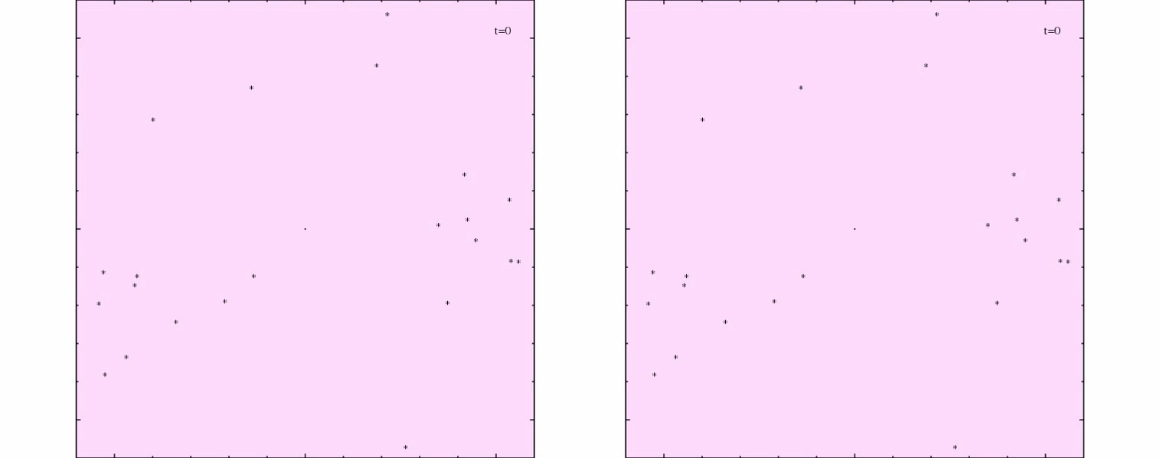
SMBH Outflow
radiatively inefficient accretion flow (RIAF) (Wang+13)
increased X-ray activity in past
(Ponti+10)
Cuadra+15
v_outflow = 5e8 km/s Mdot_out = 1e-4 v_outflow = 1e9 km/s

Slide 9
SMBH Outflow
radiatively inefficient accretion flow (RIAF) (Wang+13)
increased X-ray activity in past
(Ponti+10)
Cuadra+15
v_outflow = 5e8 km/s Mdot_out = 1e-4 v_outflow = 1e9 km/s

Slide 10
X-ray Calculation (Russell13)
Sum emissivities along 1D rays through simulation
Well into optically thin limit, so don’t need to solve formal solution to radiative transfer
Radiative transfer program basis: SPLASH (Price07), SPH visualization code
Emissivity: APEC (Smith+01) from XSPEC (Arnaud+97)
Opacity: windtabs (Leutenegger+10)
ISM Opacity: TBabs (Wilms+00) from XSPEC

Slide 11
X-ray Calculation (cont.)
Abundances:
WN8-9 & Ofpe/WN9: CMFGEN models http://kookaburra.phyast.pitt.edu/hillier/web/CMFGEN.htm
WN5-7: Onifer+08
WC8-9: Crowther+07
Response Function Folding
PSF Folding
-> Direct comparison with observations
one free parameter: n_{H} (ISM absorbing column)

Slide 12
X-ray Image: Models vs. Data
4-9 keV ACIS-S 0th Order HETG ±6”

Slide 13
X-ray Image: Models vs. Data
4-9 keV ACIS-S 0th Order HETG ±6”

Slide 14
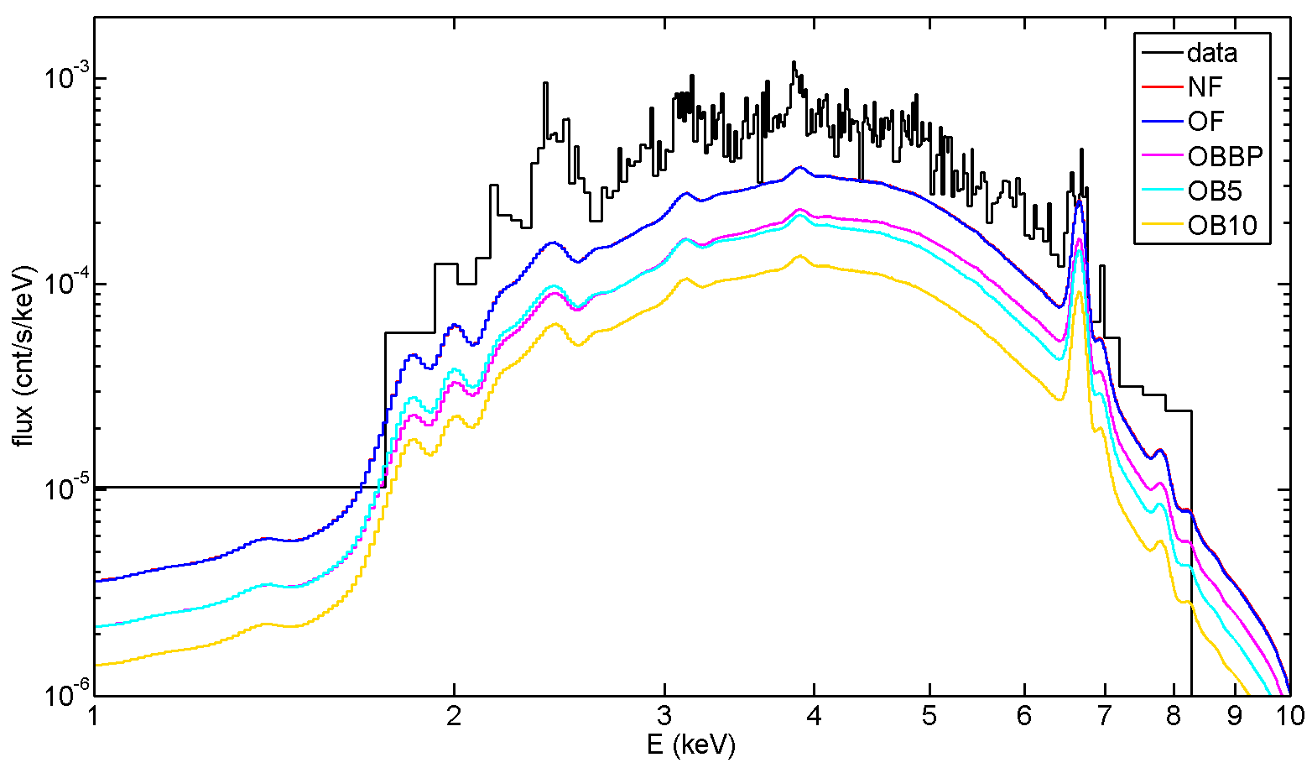
X-ray Spectra: Models vs. Data
n_{H}=1.3e23 cm⁻²
ACIS-S 0th Order HETG 2”-5” excluding IRS13E & PWN

Slide 15
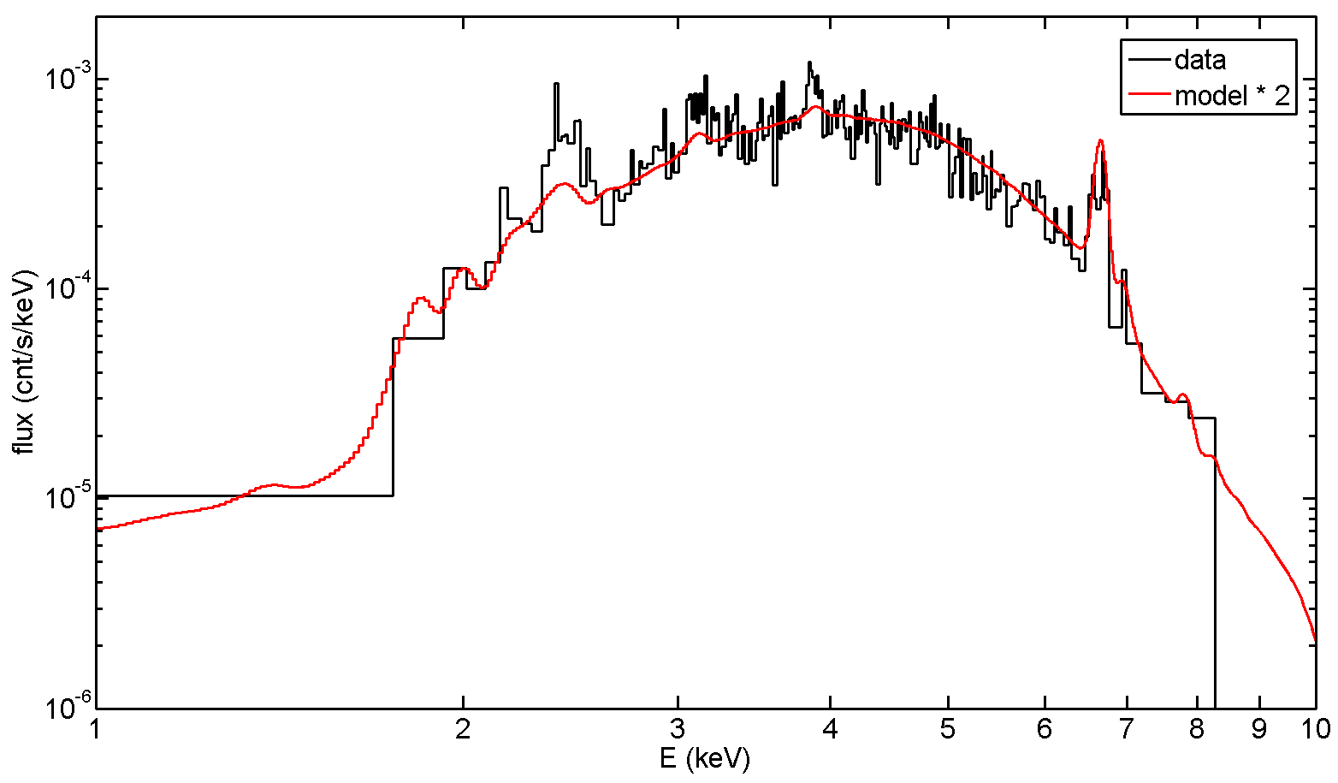
X-ray Spectra: Models vs. Data
n_{H}=1.3e23 cm⁻²
Excellent shape agreement
(not a fit)
Model flux 2x too low
ACIS-S 0th Order HETG 2”-5” excluding IRS13E & PWN

Slide 16
Summary
3D Hydro + Radiative Transfer -> Model X-ray observation of Galactic center
Spectral shape: excellent agreement -> diffuse emission comes from shocked WR winds
Flux level: 2x too low
Mdot increase of sqrt(2) = 1.4 -> small adjustment
Add in O stars & binaries
Future Work: Improved hydro methods
SPH method: “pressure-entropy” (Saithoh&Makino13; Hopkins13)
Moving-mesh: GIZMO (Hopkins15)

Slide 17
Extra Slides

Slide 18
ρ
T
6” x 6”
2 keV X-rays
7 keV X-rays

Slide 19
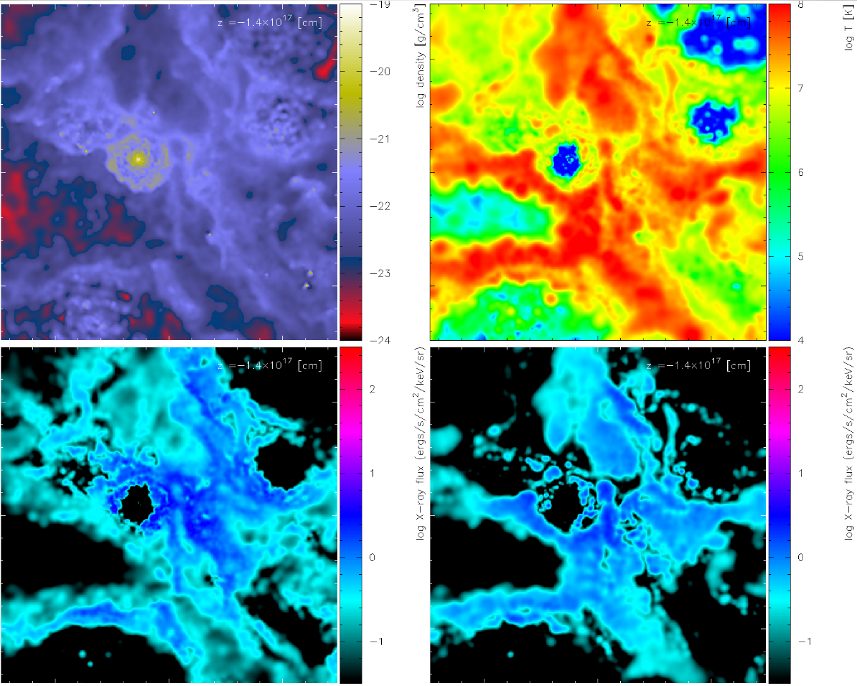
ρ
T
6” x 6”
2 keV X-rays
7 keV X-rays

Slide 20
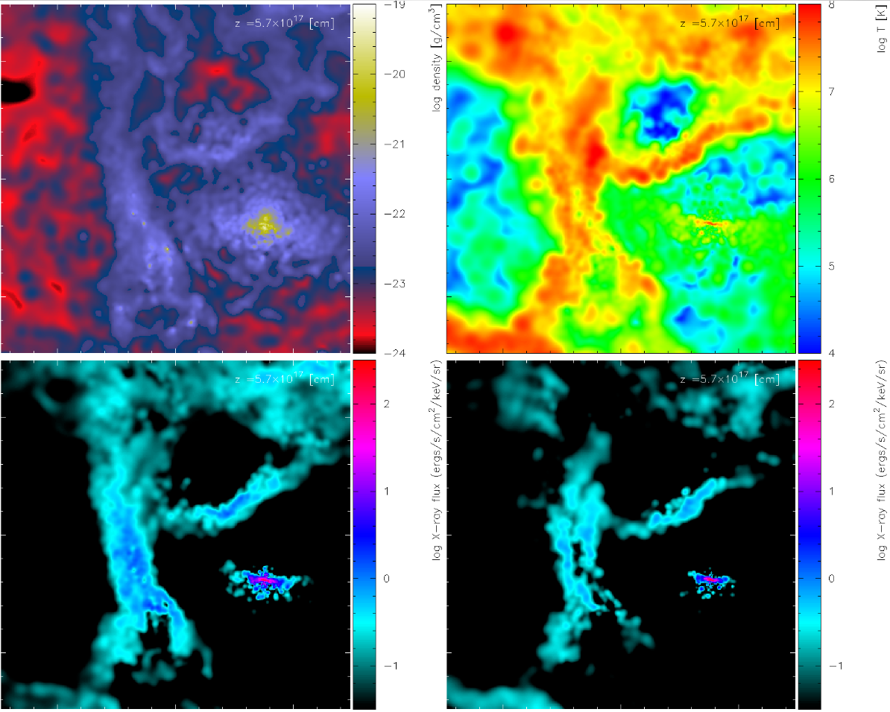
ρ
T
6” x 6”
2 keV X-rays
7 keV X-rays

Slide 21
X-ray Image: Models vs. Data
4-9 keV ACIS-S 0th Order HETG ±6”

Slide 22
X-ray Image: Models vs. Data
4-9 keV ACIS-S 0th Order HETG 2”-5”

Slide 23
WR Abundances
mass fractions (%)

